Slide 1
Summer Olympic Host Cities
Name: Class:

Slide 2
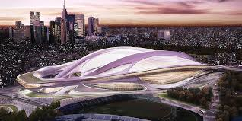
Tokyo 2020

Slide 3
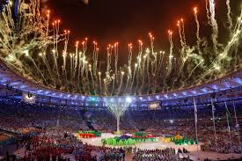
Rio 2016

Slide 4
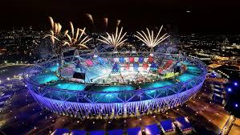
London 2012

Slide 5
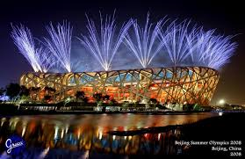
Beijing 2008

Slide 6
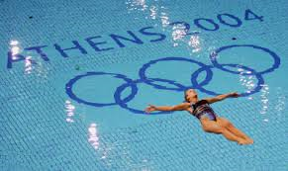
Athens 2004

Slide 7
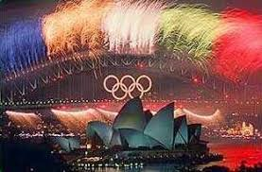
Sydney 2000

Slide 8
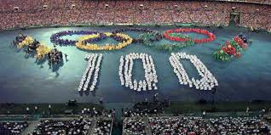
Atlanta 1996

Slide 9
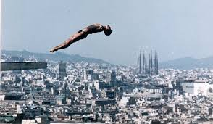
Barcelona 1992

Slide 10
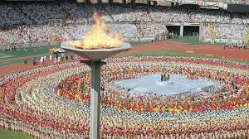
Seoul 1988

Slide 11
Los Angeles 1984

Slide 12
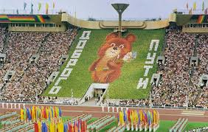
Moscow 1980

Slide 13
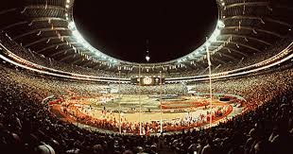
Montreal 1976

