Slide 1
Small people, big actions!

Slide 2
Look through the power point to see what some children in the UK have been doing to help keep our oceans plastic free.

Slide 3
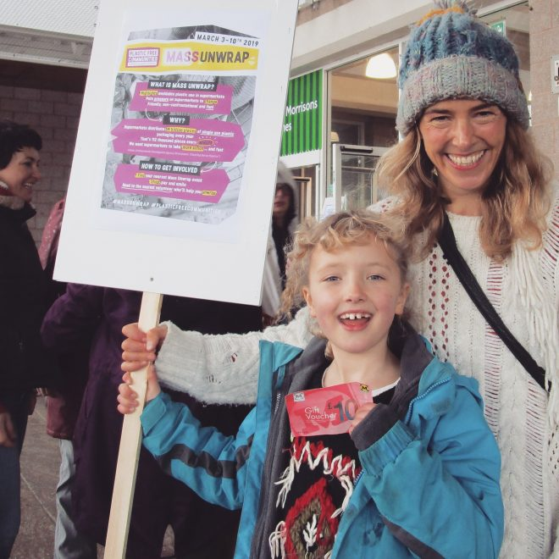
Maya, aged 8 from Totnes has written letters to the local supermarket asking them to consider a plastic free aisle.
She has also persuaded her school to become a Plastic Free School!

Slide 4
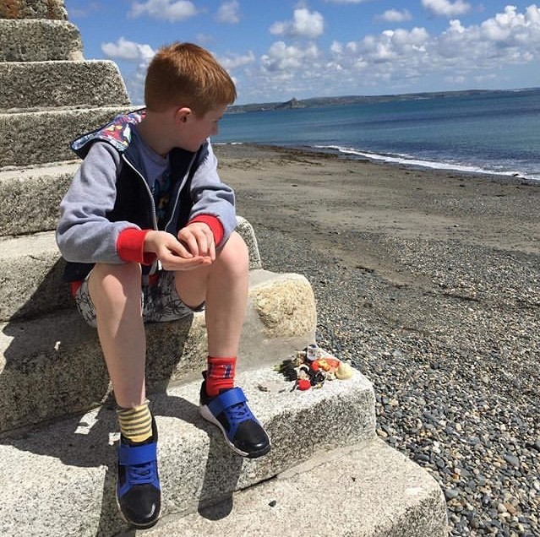
Louis , aged 11, regularly attends beach cleans in his town, Penzance.
He makes eye-catching images of plastic pollution to grab attention and encourage people to take individual action to reduce single-use.
His pictures have inspired lots of people to reduce their use of single-use plastic.

Slide 5
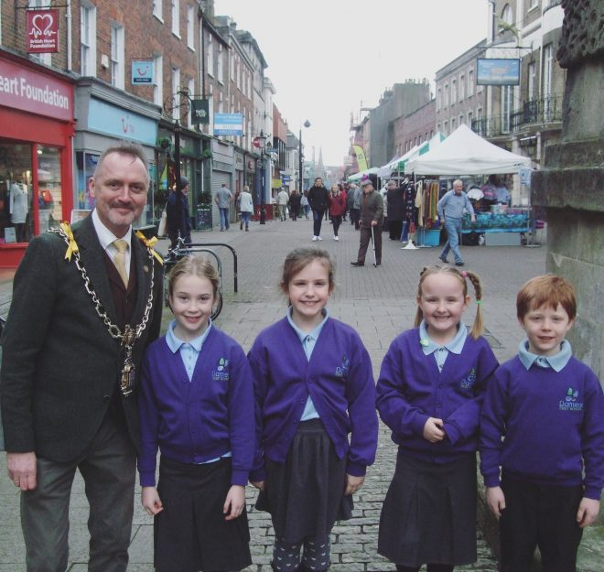
The children at Daymer’s First school in Dorchester have launched a bottle refill project to reduce plastic use. Check out their refill rap:
https://damers.wistia.com/medias/1opjxid6a6

Slide 6
What could we do at home or at school to reduce the plastic in our oceans?

