Slide 2
How Do we Know?
Talk About It
If you want to find out about an event that happened a long time ago, how would you find the information?
If we want to learn about things from the past, we could:
look it up on the Internet;
read a book;
watch a TV show about it;
ask someone who knows a lot about history.
Today, we are going to learn about someone who helped us find out information about important events that happened a long time ago.

Slide 3
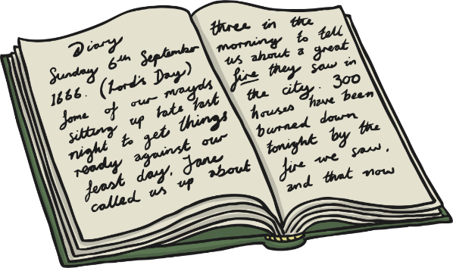
Dear Diary…
Talk About It
What is a diary? Have you ever written a diary? Why do you think people write diaries?
A diary is a place where a person records their thoughts, feelings and things that have happened to them.
People write diaries for lots of different reasons. Sometimes it helps people to write down how they are feeling. Other people like to have diaries to look back on to help them remember good times. People might share their diaries with others or keep them a secret.

Slide 4
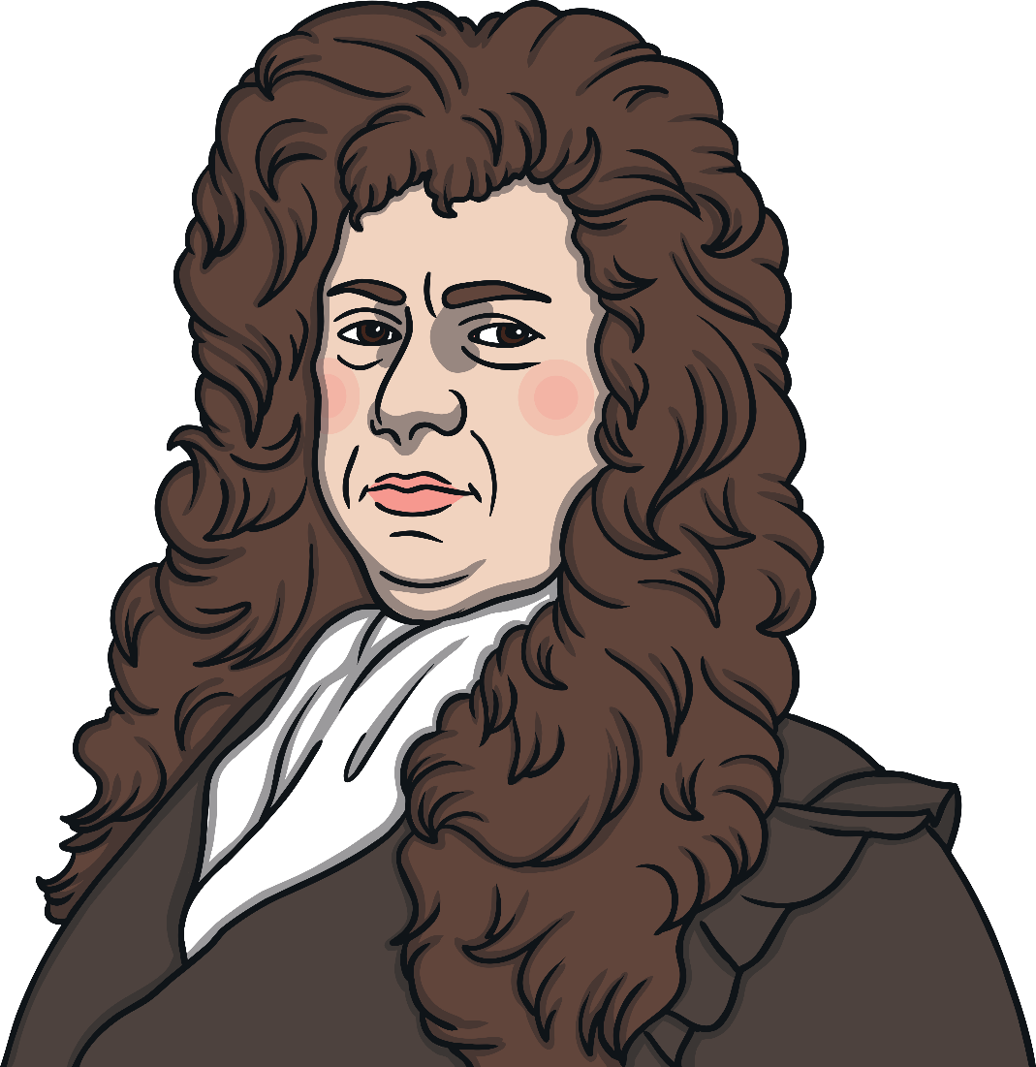
Samuel Pepys
Samuel Pepys was born a very long time ago on 23rd February 1633. His surname is pronounced ‘Peeps’.
Samuel’s dad was a tailor (a person who makes clothes). Samuel had ten brothers and sisters. When he was a child, there was a war happening called the English Civil War. Samuel’s family lived in London but he was sent away to school to keep him safe from the fighting. He later returned and went to St Paul’s school in London.
After Samuel had finished school, he carried on learning at a place called Cambridge University. A university is like a school for grown ups.

Slide 5
Samuel Pepys
When Samuel had finished university, he got a job working for the navy (an organisation that fights wars at sea).
In 1655, Samuel married Elizabeth Marchant de Saint-Michel. She was only 15 years old when they got married but this was considered normal at the time.
Samuel became a Member of Parliament in 1673. This means he was one of the people who helped to run the country.

Slide 6
Starting a Diary
Samuel lived in very interesting times. After the English Civil War, the country didn’t have a king for a long time. There were lots of changes and people were unsure about what was going to happen next.
On 1st January 1660, Samuel decided to start writing a diary to keep a record of events. His first diary entry talked about problems there were with the people ruling England, how he had been to church, what he had eaten and that his wife Elizabeth had burnt her hand while she was cooking.
Did You Know?
Samuel wrote his diary in a special code so no one could read it, not even his wife!

Slide 7
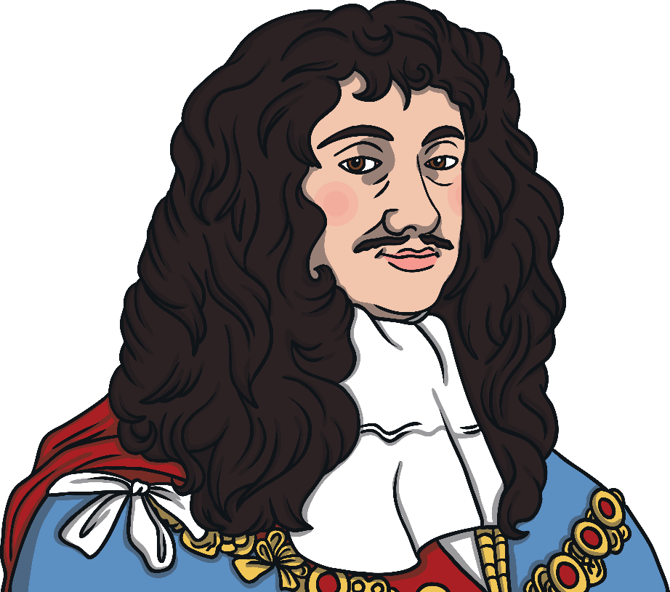
Charles II
It is thanks to Samuel’s diaries that we know lots about important events from the past.
One of these events is the coronation of Charles II in April 1661. A coronation is when a new king or queen is crowned.
This event was important because England hadn’t had a king for a long time following the English Civil War.
Samuel was at the coronation and described in his diary that when the crown was placed on his head there was lots of cheering. He also complained that there were so many people that he couldn’t see everything that was going on.

Slide 8
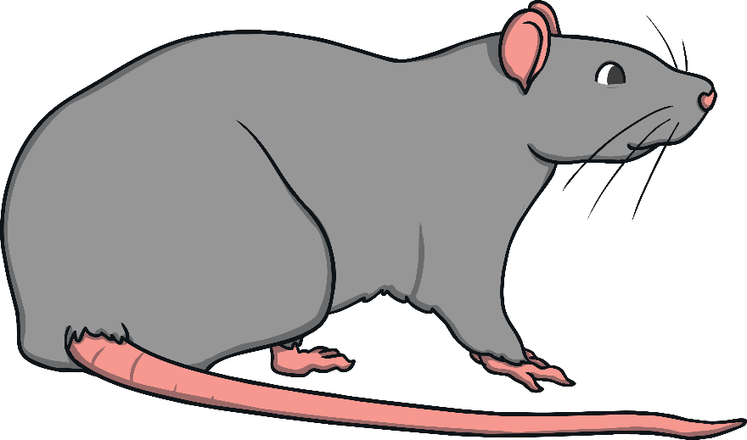
The Plague
Another event we know lots about thanks to Samuel’s diary is an illness called the plague. People all around Europe became very poorly, often having a fever or chills, headaches and aching bodies, being sick and lumps appearing all over them.
At the time, people didn’t know how the plague was being spread. We now know it was carried through bacteria found on fleas on rats. The plague was passed to humans if they were bitten by a flea.

Slide 9
The Plague
In June 1665, Samuel wrote in his diary that he had seen “two or three houses marked with a red cross upon the doors.” This was the sign used to warn people not to enter houses as the people living in them had the plague. He also wrote about how people, including the King’s mother, were leaving London to avoid the plague.
On 22nd July, more people were getting ill. Samuel wrote that the streets were “mighty thin of people” meaning that there weren’t many people around.
By 30th August, Samuel said that people were talking about “death, and nothing else.”
Samuel’s diary helps us to understand what a frightening time it was for people.

Slide 10
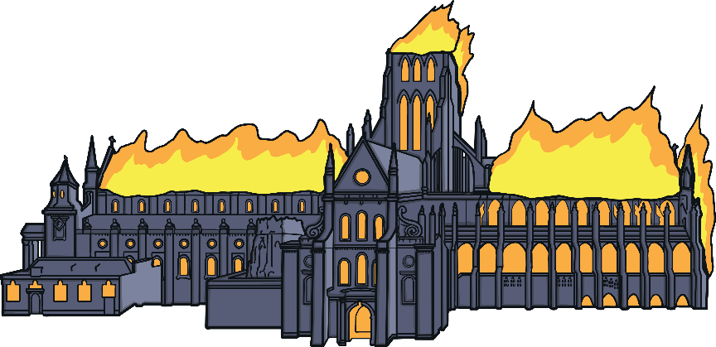
The Great Fire of London
Another event we know lots about because of Samuel’s diary is the Great Fire of London which happened in 1666.
On 2nd September at 1 o’clock, a fire started in a bakery in a road called Pudding Lane. As most houses in London were made of wood and it had been a very hot summer, the fire spread quickly.
His diary entry for that day explains that Samuel met King Charles II and his brother the Duke of York. Samuel told the King that unless he ordered “houses to be pulled down nothing could stop the fire. They seemed much troubled, and the King commanded me to go to my Lord Mayor from him, and command him to spare no houses,
but to pull down before the fire
every way.”

Slide 11
The Great Fire of London
Samuel wrote about how people left London to escape the fire and how before doing so, they hid their belongings so people wouldn’t steal them. On 4th September, he wrote that he dug a hole and “ put our wine in it; and I my Parmesan cheese, as well as my wine and some other things”.
His diary entry for 5th September describes travelling around London and seeing many buildings destroyed by fire. This has helped people understand how far the fire spread.
By the 7th September, the fire was out. Samuel wrote that he got up at 5 a.m. and walked around the city seeing the “miserable sight” of the ruined St Paul's Cathedral and other
important buildings that had
been destroyed.

Slide 12
Later Life
Samuel’s diary also contained details about music he enjoyed listening to, friends he had and his favourite meals.
Samuel stopped writing his diary in 1669, the same year that his wife Elizabeth died.
Samuel died on 26th May 1703.

