Slide 1
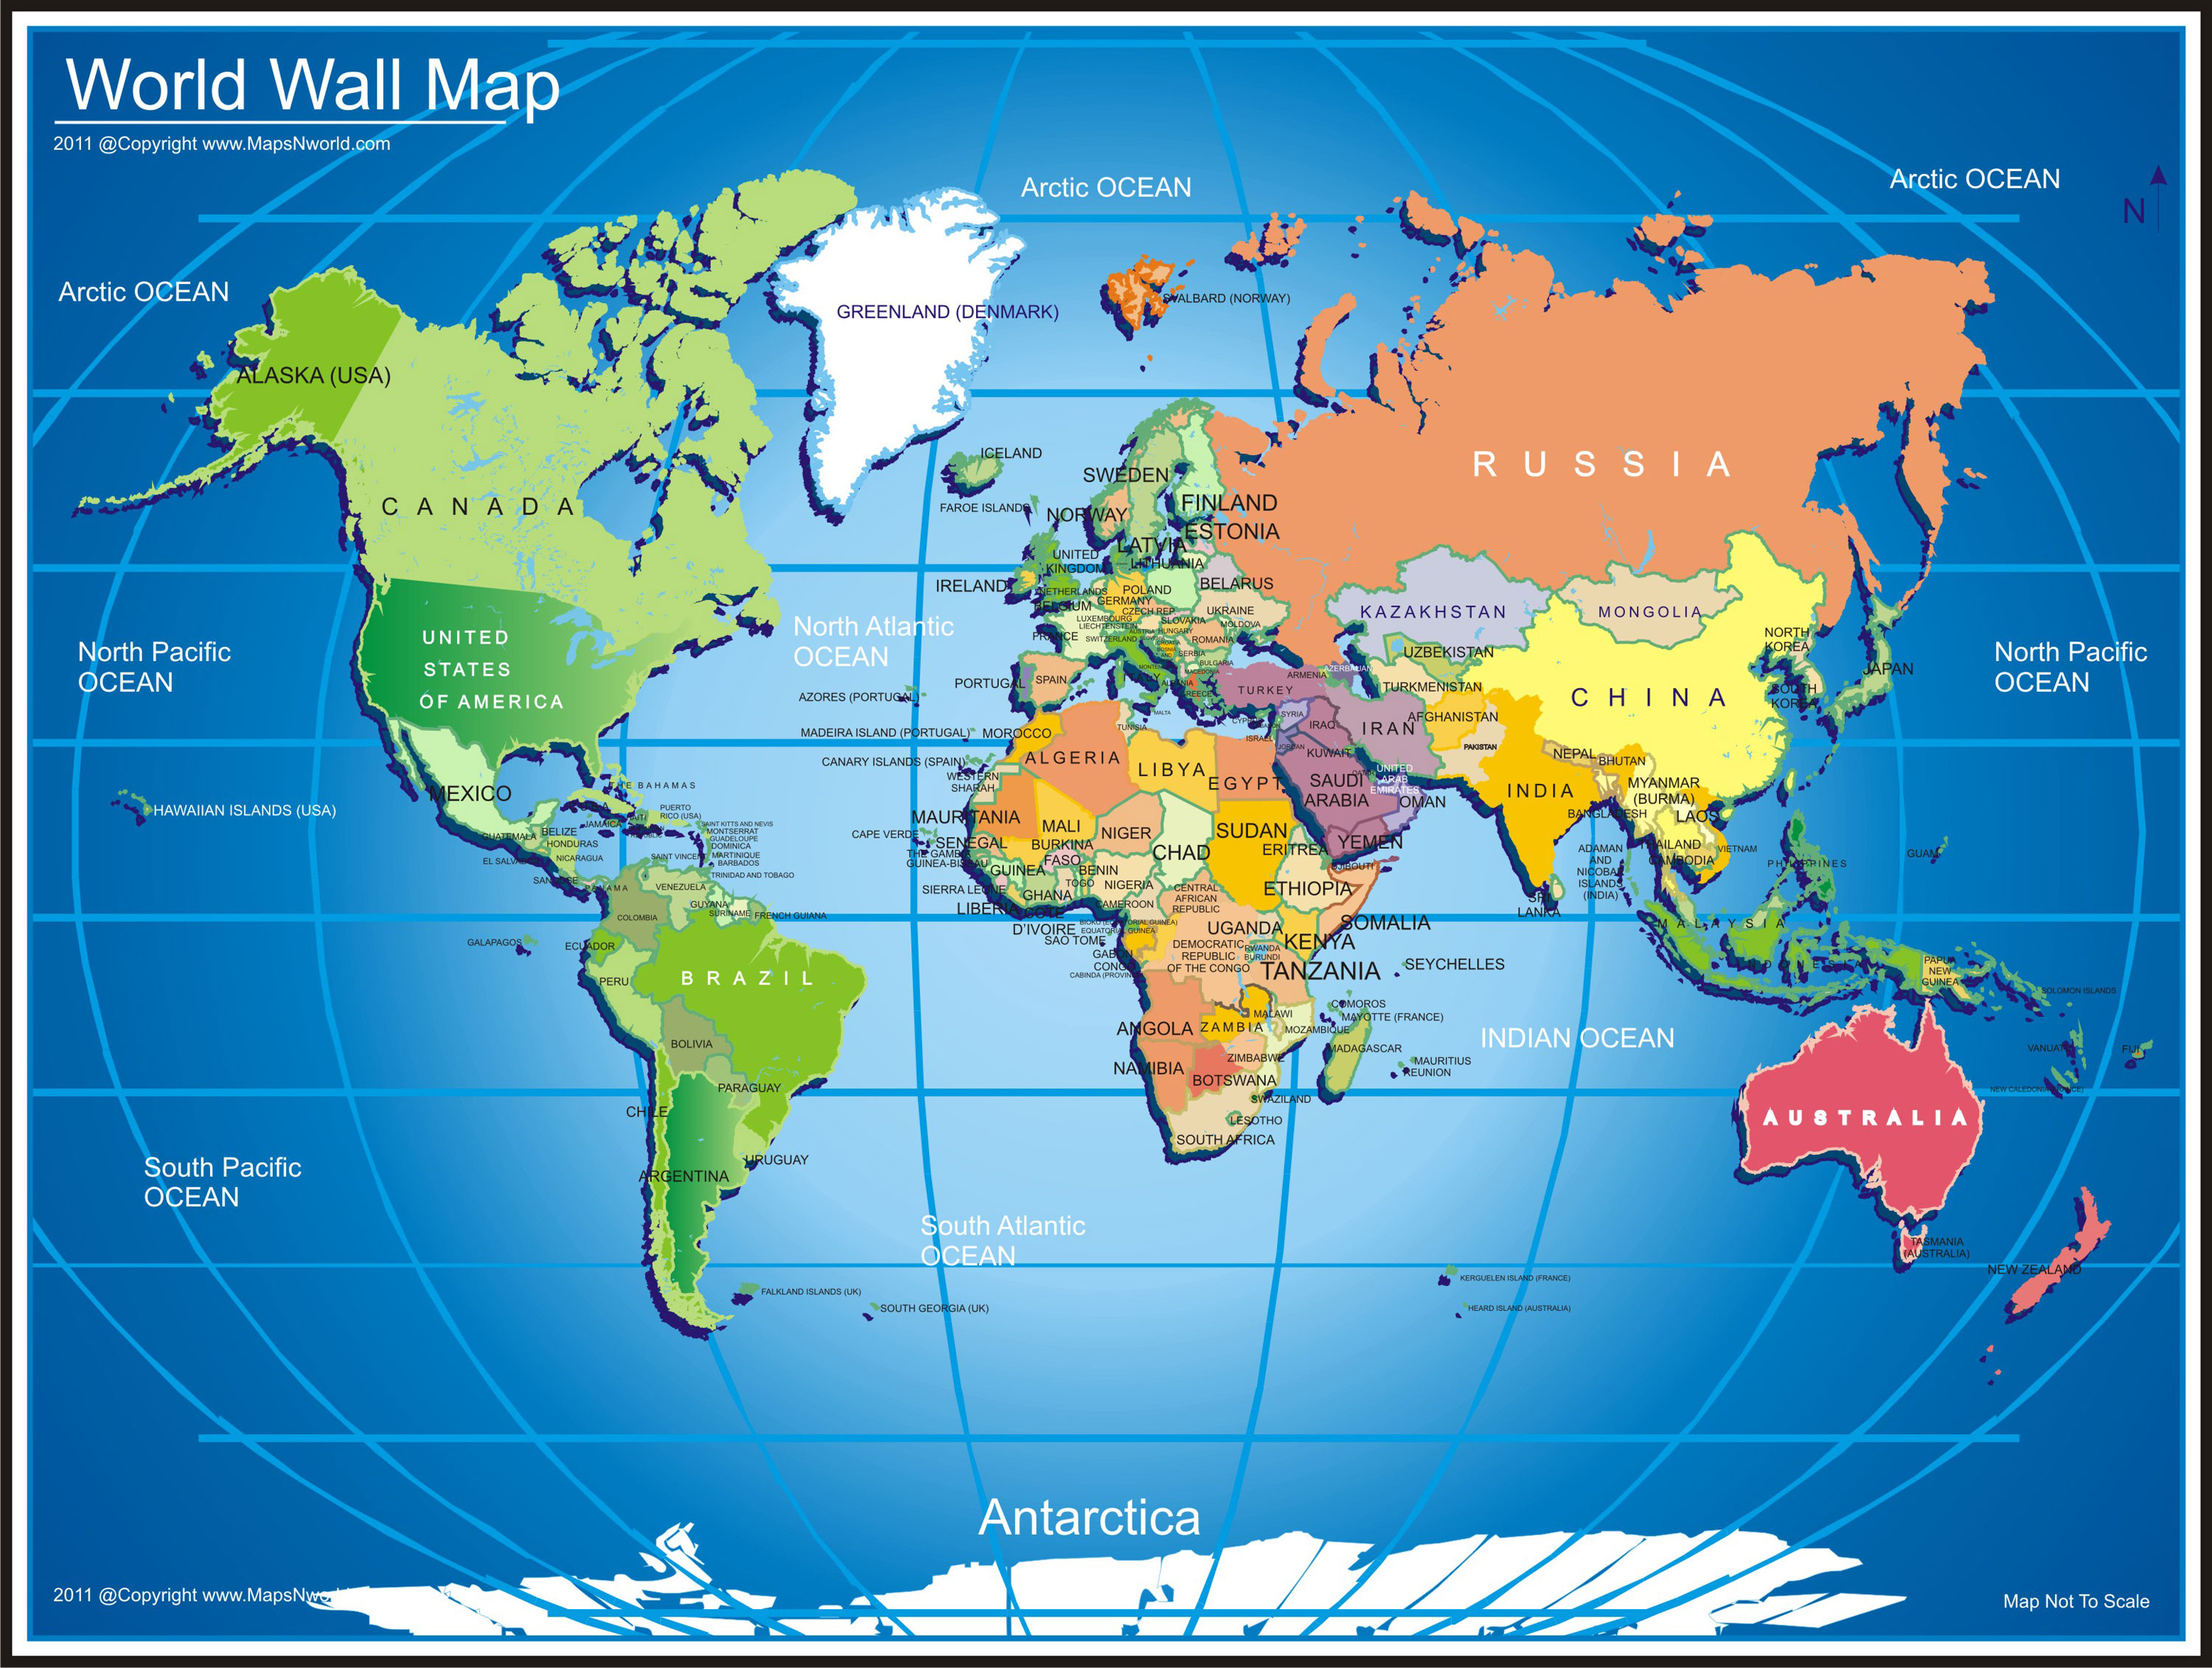
Flags of the World

Slide 2
Spain

Slide 3
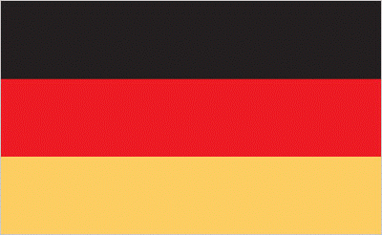
Germany

Slide 4
Brazil

Slide 5
Argentina

Slide 6
Canada

Slide 7
Mexico

Slide 8
Australia

Slide 9
New Zealand

Slide 10
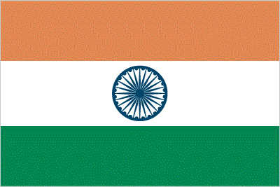
India

Slide 11
Japan

Slide 12
Egypt

Slide 13
South Africa

