Slide 1
Famous People Throughout History

Slide 2
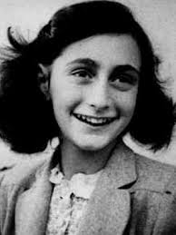
Anne Frank

Slide 3
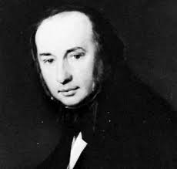
Isambard Kingdom Brunel

Slide 4
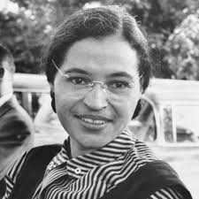
Rosa Park

Slide 5
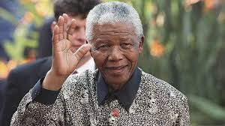
Nelson Mandela

Slide 6
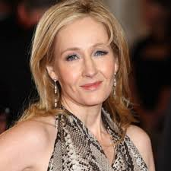
J K Rowling

Slide 7
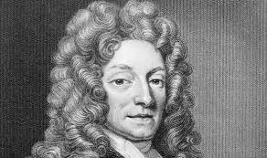
Sir Christopher Wren

Slide 8
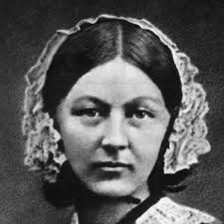
Florence Nightingale

Slide 9
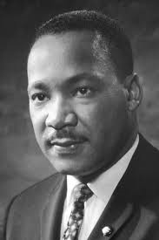
Martin Luther King

Slide 10
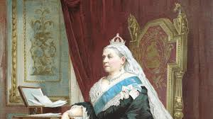
Queen Victoria

Slide 11
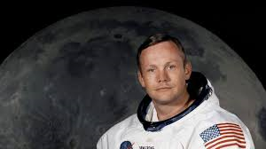
Neil Armstrong

